Slide 1
Modeling Civil Law Adjudication
Lewis A. Kornhauser
LAWLE X
21 November 2024

Slide 2
Judicial Behavior
Learning the Law
Adapting to Change
Hierarchical Management
Collegial Decisions
Dispositions
Rules
Reasons

Slide 3
Two Modeling Approaches
Political Models
Team models

Slide 4
The Political Approach
Judges have different preferences.
Adjudicatory institutions structure the conflicts among judges
Most of the modeling of US courts adopts a political approach

Slide 5
The Team Perspective
Key idea: All judges, whether on the same court or at different levels of a hierarchy
Errors are mistakes
  Due to asymmetric & costly information
Appeals reveal hidden info, allow learning & deliberation
Focus of analysis: Efficiency or error minimization
Team approach favored by economists & the legal academy

Slide 6
3 Broad Classes of Team Models
Knowledge Hierarchy
  Focus is on efficient division of labor – who controls what tasks, specialization
Classical Team Models
  Focus is on managing groups with decentralized information – aggregating information & coordinating actions
Distributed processing
  Focus is on distributed processing of information.

Slide 7
Lessons from the US Models
General
Internal rules of decision matter a lot
Case selection/location matters
Litigant Selection plays a significant role

Slide 8
Lessons from the US Models
Learning and Adaptation
A practice of stare decisis facilitates learning

Slide 9
Lessons from the US Models
Collegiality
Non-median judge outcomes
Opinion author matters
Distribution of ideal points matters
Strategic Disposal Voting is possible
Panel Effects

Slide 10
Lessons from the US Models
Hierarchy
Control possible with a relatively small number of judges
True both in Team and Political Models

Slide 11
EAL Literature on Civil Law
Anderlini, Felli, and Riboni (2014) (adaptation)
Bravo-Hurtado and Bustos (2019) (hierarchy)
Fon and Parisi (2006) (learning the law)
Iaryczower and Shum (2012) (collegial decisions)

Slide 12
The Structure of French Adjudication
Three Apex Courts
Cour de Cassation: criminal and private civil law
Conseil d’Etat: Administrative law
Conseil Constitutionel: Constitutional Law

Slide 13
Separation of Powers
Structural Response to perceived political problem
Actual structure a function of probem perceived
Typically, three “powers” considered: legislative, executive, judicial

Slide 14
What Courts Do
Modes of Judicial Decision-Making
Mode | US | France
Common Law | Yes | Yes-CdE?
Statutory Interpretation | Yes | Yes-CdC, CdE, CC
Administrative Law Procedure | Yes | Yes-CdE
Administrative Law Substantive | Yes | Yes-CdE
Constitutional Review (Ex post) | Yes | Yes-CC
Constitutional Review (Ex Ante) | No | Yes-CC
CdC = Cour de Cassation; CdE=Conseil d’Etat; CC= Conseil Constitutionel

Slide 15
France and the US Compared
Management of the Case Flow
Specialization of Judges
Rapporteur
Avocat General
Announcement Practices

Slide 16
Are French Judges a Team?
Training
Selection

Slide 17
The Structure of the Cour de Cassation
Divided into 6 Chambers: 5 Civil, one criminal
Each Chamber is divided into sections
Roughly 200 judges allocated among the 6 Chambers
Notes:
.

Slide 18
Civil Case Load on CdC
Roughly 10% of all cases from the cours d’appel are appealed to the CdC
Roughly 20% of filed appeals, fail
So CdC is deciding roughly 8% of civil matters decided by the cours d’appel.
The CdC is deciding roughly 9,200 civil cases a year.

Slide 19
Life History of A Case
Case Arrives
Premier President designates a Chamber
The Chamber president designates a rapporteur
The rapporteur and avocat general produce reports
Hearing
Deliberation
Decision by majority rule.

Slide 20
Panel Formations
Formation | Number of Judges
Restricted Panel | 3
Section Panel | ≥ 5
Plenary Chamber | ≥ 5
Mixed Chamber | 13
Plenary Assemby | 19

Slide 21
% Decisions by Panel Formation
Year | #Cases | 3 | Section | Mixed | Plenary
2018 | 11,084 | 92.6 | 7.0 | - | 0.4
2019 | 10,149 | 92.9 | 7.0 | - | 0.2
2020 | 8,593 | 94.3 | 5.5 | 2 | 0.2
2021 | 9,067 | 93.2 | 6.5 | 3 | 0.2
2022 | 9,208 | 93.0 | 6.8 | 3 | 0.2

Slide 22
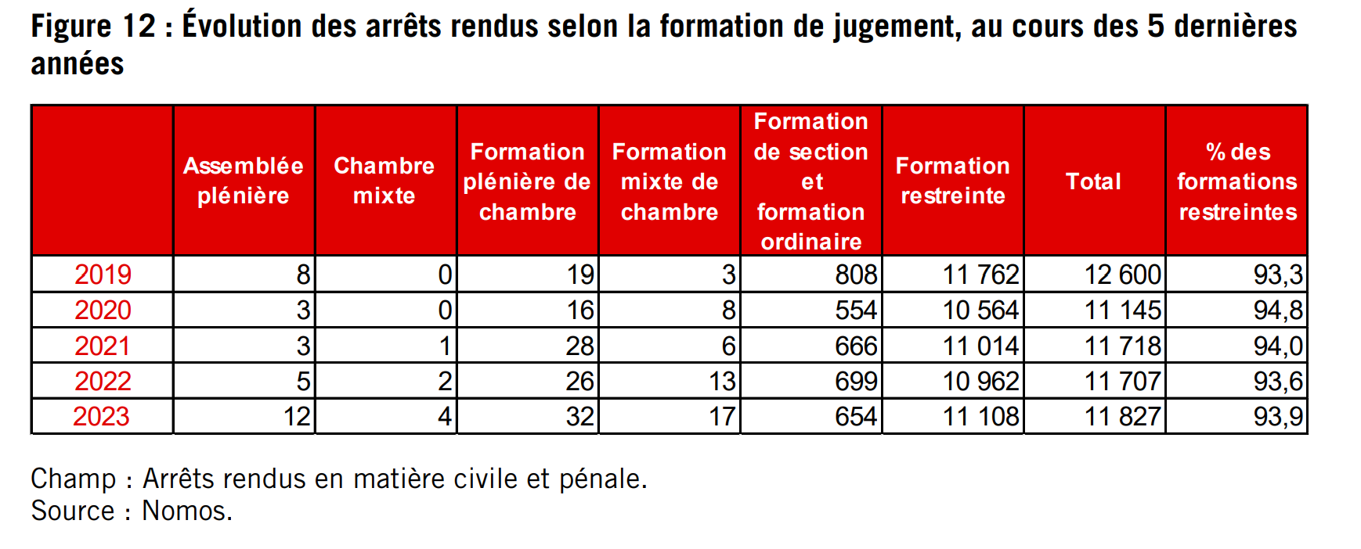
Distribution of All Decisions by Formation
Notes:
Source 2023 Annual eport

Slide 23
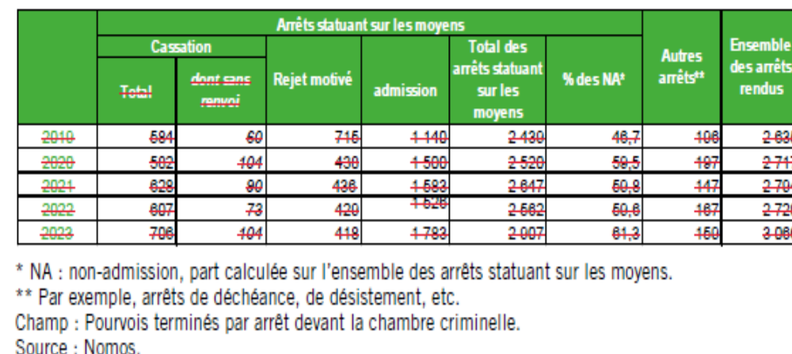
Types of Arrets, Criminal Chamber

Slide 24
“Specialization”
Specialization facilitates the processing of mass cases
The pyramidal structure of panel sizes increases judicial competence in two ways:
The Condorcet jury theorem: more and better judges
More diverse backgrounds

Slide 25
Rapporteur
Two different roles
Agenda setter
Author of first draft

Slide 26
Avocat General
Prior to roughly 2005, a much more important role.
Important because of publication?

Slide 27
Announcement Procedures I
Per curiam (but decision reached by majority rule)
Panel formation and rapporteur indicated
Opinions are very terse (though not as terse as before)

Slide 28
Announcement 2
Publication
All judgments are available on line
Some opinions are published in the Court’s Bulletin or Annual report (or both)
Some opinions are also accompanied by a press release
Some also published in some private journals that provide a short commentary

Slide 29
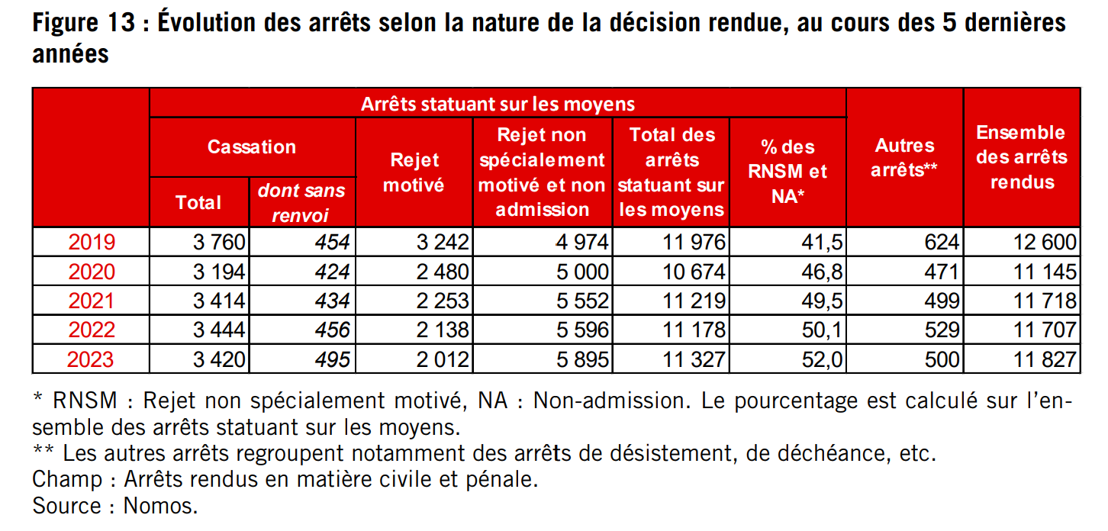
Judgments by nature of disposition

Slide 30
Conseil d’Etat
The Administrative Law Courts
There is no code of administrative law
So in principle the court looks more like a common law court
But, the institutional structures are very similar to those of the Cour de Cassation

Slide 31
Panel Formations
Conseil d’Etat
Formation | Panel Size
Plenary | 17
Section | 15
Chambres Reunies | 9
Single Chamber | 3
By “ordonnance | 1
By section ordonnance | 1

Slide 32
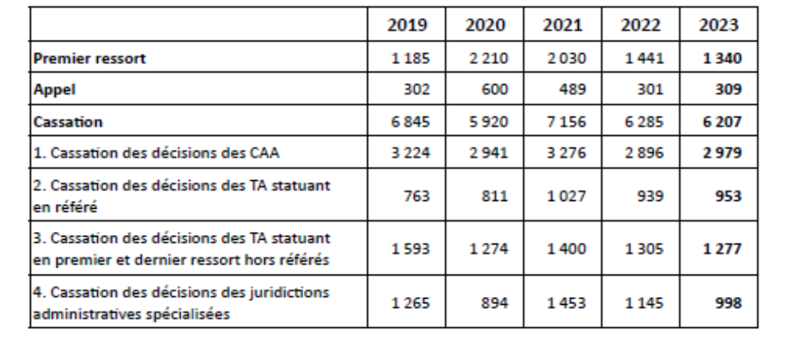
Conseil d’etat caseload

Slide 33
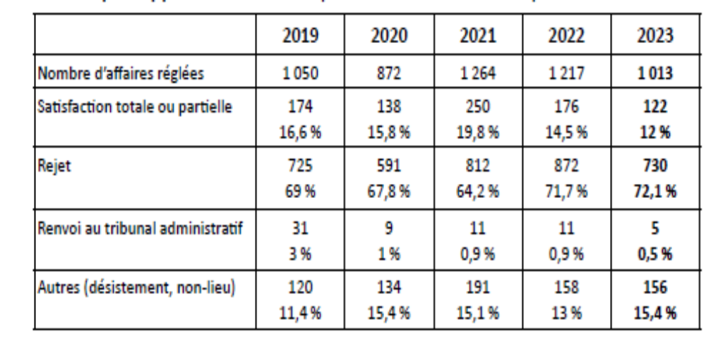

Slide 34
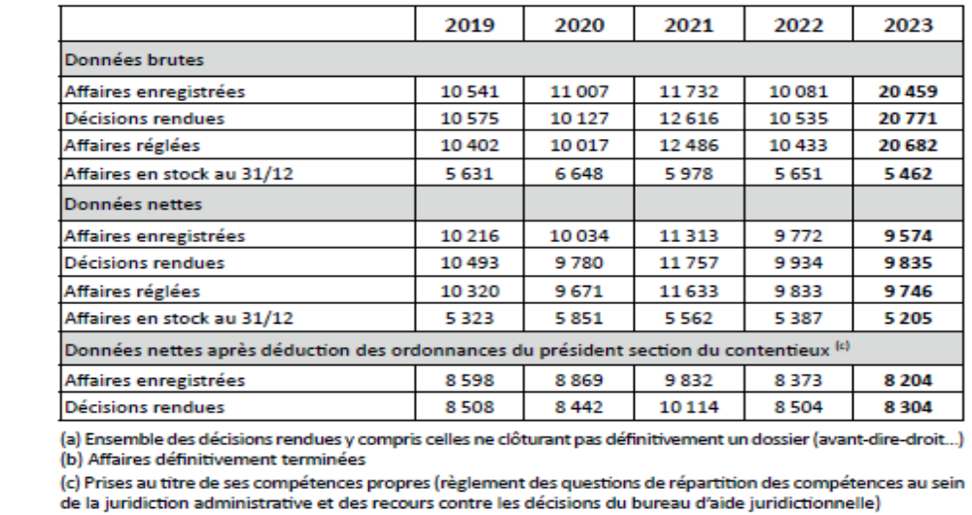
Caseload: Conseil d’Etat

Slide 35
Announcement Procedures
Conseil d’Etat
Per Curiam
Short opinions (But longer than those of CdC)

Slide 36
Publication Practice
Monthly Publication of Opinions in official journal

Slide 37
Concluding Remarks I
French System
Case Load
Specialization
Rapporteur
Avocat General
Publication

Slide 38
Concluding Remarks II
The Way Forward
Model the French system as a team
Emphasize the organizational structure as an efficient method of accurate case disposition and hierarchical management

